Slide 1
RFID Technology
Overview

Slide 2
RFID – What is it?
Radio Frequency Identification Device
Holds a small amount of unique data – a serial number or other unique attribute of the item
The data can be read from a distance – no contact or even line of sight necessary
Enables individual items – down to the proverbial “can of beans” to be individually tracked from manufacture to consumption!

Slide 3
RFID Tag Attributes
 | Active RFID | Passive RFID
Tag Power Source | Internal to tag | Energy transferred using RF from reader
Tag Battery | Yes | No
Availability of power | Continuous | Only in field of reader
Required signal strength to Tag | Very Low | Very High
Range | Up to 100m | Up to 3-5m, usually less
Multi-tag reading | 1000’s of tags recognized – up to 100m | Few hundred within 3m of reader
Data Storage | Up to 128Kb or read/write with sophisticated search and access | 128 bytes of read/write

Slide 4

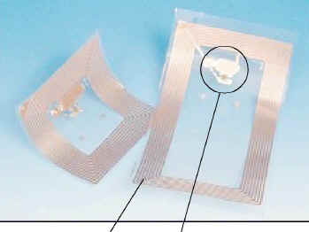
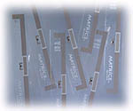
Passive RFID Tags
“Traditional” tags used in retail security applications
  Tag contains an antenna, and a small chip that stores a small amount of data
  Tag can be programmed at manufacture or on installation
  Tag is powered by the high power electromagnetic field generated by the antennas – usually in doorways
  The field allows the chip/antenna to reflect back an extremely weak signal containing the data
  Collision Detection – recognition of multiple tags in the read range – is employed to separately read the individual tags
These passive tags form the basis of the Auto-ID designs, and, if manufactured in billions, will come down in price from $0.80 to $0.05 in the next 2 years.

Slide 5
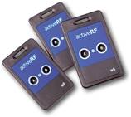
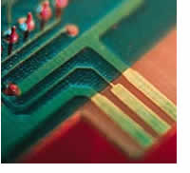
Active Tags
Battery Powered tags
  Have much greater range – 100m
  Hold much more information – Kbytes
  Can integrate sensing technology
    Temperature, GPS
  Can signal at defined time
  Multiple tags can be recorded at once
Used for higher value items
  Shipping containers
  Babies
  Electronic assets
Cost between $20 and $40 per item
Life between 2 – 4 years

Slide 6
Auto-ID Organization
Non-profit organization supported by major software, consulting, tag and reader manufacturers and by MIT, Cambridge University and Adelaide University
All research and solutions are public domain
Developed vision of global approach to automatic ID of every product
Developed standards for tags and readers
Developed high level designs that will bring tag cost toward 5c and readers to $100
Developed – with SUN – Savant software to act as mediation between readers and a global network of “name servers” and databases – available as open source

Slide 7
EPC Network – Building Blocks
Tags | Data carrier – the ID number – Unique EPC Code – is programmed into the Tag
Tag Antenna | Connected to chip in Tag – could be wire or printed using conductive ink
Reader Antenna | Coil included in plastic or similar case – usually 12 – 18 inches square
Reader | Data capture device – interrogates the tag and retrieves the data from all tags in the receiving area. Can be fixed or portable
Savant | Servers/Software to support readers, extract unique information from the read data, and communicate with External databases
ONS | Object Name Service – similar to DNS in the Internet – knows the appropriate database holding full information about the product the tag is attached to

Slide 8
EPC Code
eg 613.23000.123456.123456789 (96 bits)
Header – defines data type (8 bits)
EPC Manager – describes originator of EPC (Product manufacturer) (34 bits)
Object Class - Could describe the product type (20 Bits)
Serial Number – Unique ID for that product item (34 Bits)

Slide 9
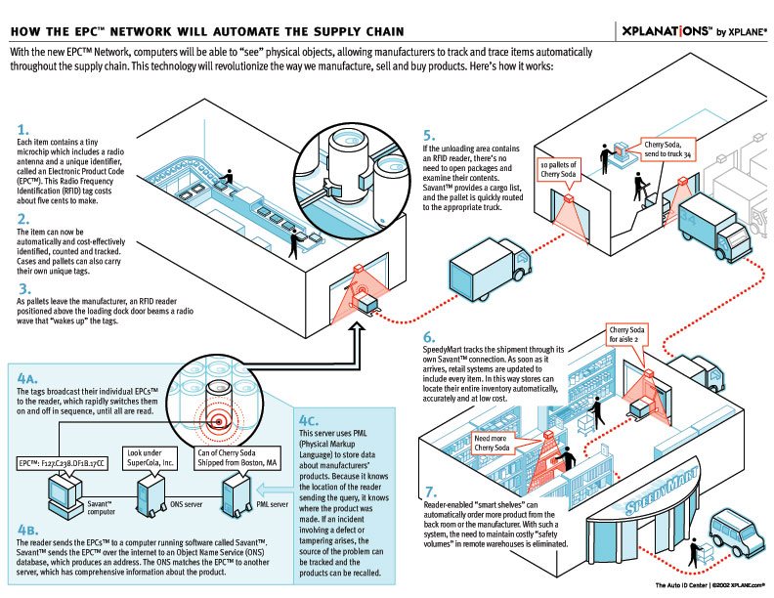
Supply Chain – Global Vision

Slide 10
Auto-ID Implications
Harnessing research and major software/hardware companies to align with common standards and open source “middleware”
End result:
  Commonality of standards of tags and readers
  Lowest potential cost for hardware components
  Application software will become the “missing link” and differentiator

